Slide 1







Digital portfolio
Student Name: HariHaran A
Register no:asbrubd2428k0026
Department: BSC (AI&DS)
College:Shree Venkateshwara Arts and Science (co-education) College-Othakuthirai
University:Bharathiar University

Slide 2



HariHaran
Portfolio
Project
Title

Slide 3




Agenda
5
Portfolio design and
layout
problem statement
1
6
Features and Functionality
Project overview
2
End Users
3
7
Result and screenshot
Tools and Technologies
4
Conclusion and
GitHub Link
8

Slide 4


In today’s world, students and organizations often struggle with manual work and limited access to smart tools.
This leads to delays, errors, and inefficiency in handling tasks.
My focus is on creating digital solutions that are simple, reliable, and effective.
Through my projects, I aim to make technology more helpful and accessible for everyone.
Problem statement

Slide 5
My projects focus on solving real-world problems using programming and technology.
They include applications in areas like data processing, automation, and user-friendly systems.
Each project is designed to improve efficiency, reduce errors, and create practical solutions.
Through these works, I aim to blend creativity with technical skills for impactful results.
Project Overview

Slide 6
The end users of my projects are mainly students, teachers, and professionals who benefit from simple and efficient tech solutions.
They use these applications to save time, reduce manual work, and improve accuracy.
My goal is to make technology accessible and useful for everyday needs.
The solutions are designed to be user-friendly so that even non-technical users can adapt easily.
End Users

Slide 7
I have used CodePen, an online development environment, to practice and showcase my front-end coding projects. It allows me to test HTML, CSS, and JavaScript instantly in the browser.For storing and displaying images, I prefer image hosting websites such as ImgBB or Postimages, which provide a simple way to upload images and generate links for easy integration into my projects.These tools help me work more efficiently by offering quick previews, easier sharing, and seamless embedding of media into my portfolio.
Tools and Technologies

Slide 8


A portfolio design and layout should be clean, professional, and visually appealing to highlight personal achievements and skills. It organizes content into clear sections like About Me, Education, Skills, Projects, and Contact for easy navigation. Using consistent colors, borders, and spacing creates balance, while modern layouts with cards, timelines, and grids make the portfolio interactive. A well-structured design not only represents information but also leaves a lasting impression on viewers.
Portfolio Design and Layout

Slide 9


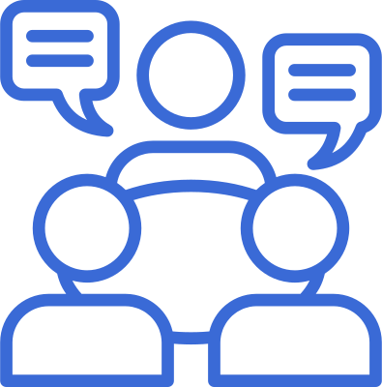
A portfolio’s features and functionality focus on making the site user-friendly, interactive, and informative. Key features include a responsive layout that works across devices, easy navigation through menus, and dedicated sections for education, skills, and projects. Functionality such as contact forms, smooth scrolling, and light/dark themes add convenience for users. Together, these elements make the portfolio both engaging and practical for showcasing talent effectively.
Features and Functionality

Slide 10
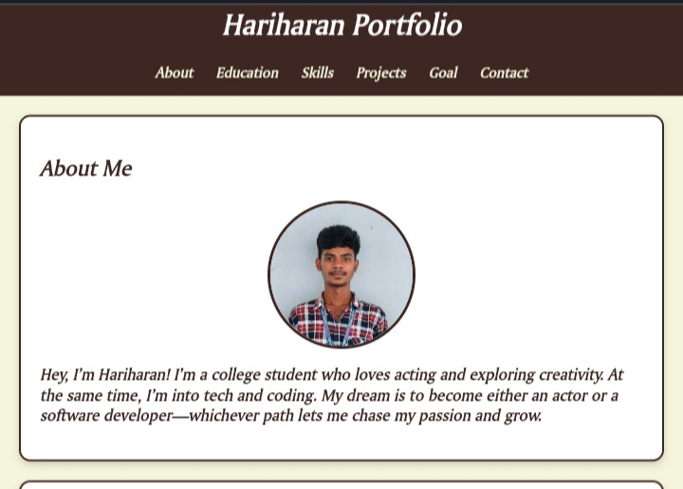
Result and screenshot

Slide 11
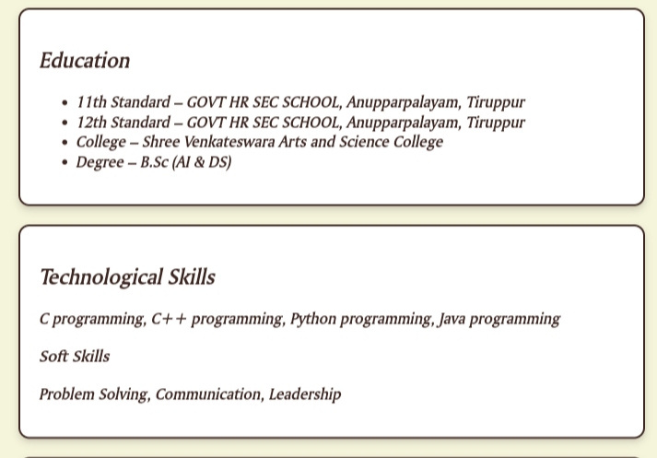

Slide 12
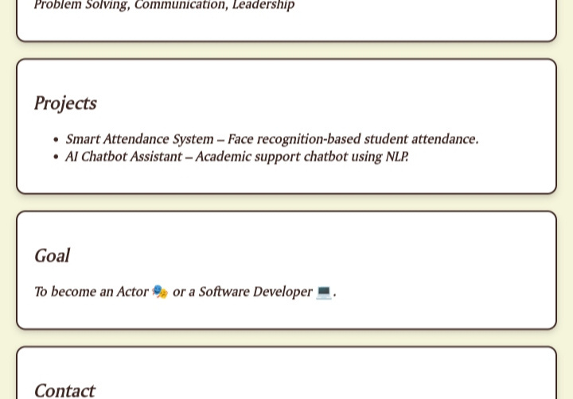

Slide 13
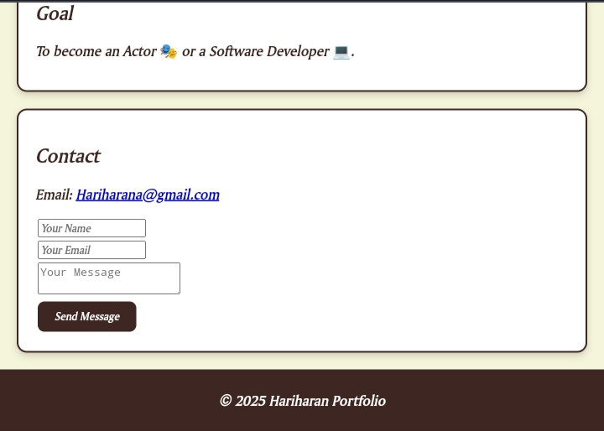

Slide 14


In conclusion, this portfolio highlights personal growth, academic achievements, and creative as well as technical skills. It serves as a reflection of passion, dedication, and career goals while offering a platform to showcase projects and talents. With continuous learning and improvement, the portfolio will evolve as a strong foundation for future opportunities.
Conclusion

Slide 15


GitHub Link 🔗
https://github.com/hari13-web/Digital-portfolio-.git

Slide 16

Home
Service
About Us
Contact
Thank
You

